Slide 1
Transactions and Locks
Transactions
SQL Server Log and Checkpoints
Locks

Slide 2
Transactions
Transactions are all about atomicity
Atomicity – smallest grouping of one or more statement that should be considered “all or nothing”
In other words, the statements should be executed together as a unit

Slide 3
Atomicity
Suppose you are Banker and Sally wants to transfer $1000 from checking to savings
Update checking
set balance = balance – 1000
where account = “sally’
Update savings
set balance = balance + 1000
where account = ‘sally’
What if first statement executes and then system dies and second statement doesn’t execute?

Slide 4
Atomicity
A transaction says don’t execute either statement unless both are successful
We need a definitive way to mark the beginning and end of a transaction

Slide 5
Transaction
BEGIN a transaction
  Set the starting point
COMMIT a transaction
  Make the transaction a permanent, irreversible part of database
ROLLBACK a transaction
  “forget that it every happened”
SAVE a transaction
  Establish a specific marker allowing us to do only a partial rollback

Slide 6
BEGIN TRAN
BEGIN TRAN denotes the beginning of a unit
If a rollback occurs, this is the point to which all database activity will be rolled back
Everything beyond this point that is not eventually committed will be forgotten as far as database is concerned
BEGIN TRAN[SACTION]
[<transaction name>| <@transaction
variable>]

Slide 7
COMMIT TRAN
End of a completed transaction
At the point you issue commit, the transaction is considered to be “durable” – that is, the effect of the transaction is now permanent and will – can’t undo
COMMIT TRAN[SACTION]
[<transaction name>| <@transaction
variable>]

Slide 8
ROLLBACK TRAN
Undo to the beginning of the transaction
  (Exception is use of save points)
ROLLBACK TRAN[SACTION]
[<transaction name>|<save point name>
<@transaction variable>|<@savepoint
variable>]

Slide 9
SAVE TRAN
Bookmark or named place marker in transaction
  You can rollback to an exact point in the code rather than just rollback to beginning of transaction.
  Once any rollback occurs, ALL SAVEPOINTS are gone
  Save tran is not for beginners
SAVE TRAN[saction]
[<save point name> |<@save point variable>]

Slide 10
Examples of Transactions
This is a one-line transaction:
It is simple, but it is an “autocommit” transaction.
UPDATE authors SET au_fname = ‘val' WHERE au_id = '172-32-1176'

Slide 11
Examples of Transactions (cont’d)
Multi-Statement Transaction
Note that we have a BEGIN TRAN at the beginning and a COMMIT TRAN at the end. These statements start and complete a transaction. Everything inside these statements is considered a logical unit of work.
BEGIN TRAN
UPDATE authors
SET au_fname = 'Val'
WHERE au_id = '172-32-1176'
UPDATE authors
SET au_fname = 'Marc'
WHERE au_id = '213-46-8915'
COMMIT TRAN

Slide 12
Example of Rolling Back
You can also rollback a transaction if it doesn’t act as it should:
BEGIN TRAN
UPDATE authors
SET au_fname = ‘val'
WHERE au_id = '172-32-1176'
UPDATE authors
SET au_fname = ‘Valerie'
WHERE city = 'Lawrence'
IF @@ROWCOUNT = 5
COMMIT TRAN
ELSE
ROLLBACK TRAN

Slide 13
Example of Rolling Back
If @@ROWCOUNT, which holds the number of rows affected by each statement, is five then the transaction commits …otherwise it rolls back.
The ROLLBACK TRAN statement "undoes" all the work since the matching BEGIN TRAN statement. It will not perform either update statement.

Slide 14
Transaction Inside a Sproc
Most of your transactions will probably occur within stored procedures.
Create Proc TranTest1
AS
BEGIN TRAN
INSERT INTO [authors]([au_id],
[au_lname],
[au_fname],
[phone],
[contract])
VALUES ('172-32-1176',
'Gates',
'Bill',
'800-BUY-MSFT',
1)
UPDATE authors
SET au_fname = 'Johnzzz'
WHERE au_id = '172-32-1176'
COMMIT TRAN
GO

Slide 15
Transaction Inside a Sproc
There is a problem with the query on the previous slide if you really want both statements to act as a unit.
What if one portion does not work (example: the insert fails because you are inserting a duplicate primary key)?
  You'll get a primary key violation error message. The message will even tell you the that statement has been terminated…but the transaction is still going. The UPDATE statement will still run even though the insert failed and SQL Server then commits the transaction.

Slide 16
Transaction Inside a Sproc
CREATE PROC TranTest2
AS
BEGIN TRAN
INSERT INTO [authors]([au_id],
[au_lname],
[au_fname],
[phone],
[contract])
VALUES ('172-32-1176',
'Gates',
'Bill',
'800-BUY-MSFT',
1);
--Check for error after insert
--If error, rollback entire transaction and return
IF @@ERROR <> 0
BEGIN
ROLLBACK TRAN
RETURN 10
END
UPDATE authors
SET au_fname = 'Johnzzz'
WHERE au_id = '172-32-1176';
--Check error after update
--If error, rollback entire transaction and return
IF @@ERROR <> 0
BEGIN
ROLLBACK TRAN
RETURN 11
END
COMMIT TRAN
GO
Improved transaction

Slide 17
Transaction Inside a Sproc
You'll notice that we check each statement for failure. If the statement failed (i.e. @@ERROR <> 0) then we rollback the work performed so far, and use the RETURN statement to exit the stored procedure.
It's very important to note that if we don't check for errors after each statement, we may commit a transaction improperly.

Slide 18
How SQL Server Log Works
We’re going to switch gears and discuss how SQL Server updates data “behind the scenes”, specifically in relation to how the log file is used.
Keep in mind that this does not mean that you have additional steps to make when updating data – this is an explanation of how SQL Server works and becomes important later relevant to understanding transactions.

Slide 19
SQL Server Files
We think of a database as a single file, but SQL Server actually uses two different types of files
  data files
  transaction log files
The data in your database is made up of
  the physical data file or files
  any transactions committed to the log since the last checkpoint

Slide 20
Data Files
Responsible for long-term storage of all data for the database
File extension .mdf
  Usually the first data file that is created within the database

Slide 21
Transaction Log Files
Prior to being written to the data file, every transaction is first written to a transaction log file
  Responsible for storing all the transactions that are executed against a database
File extension generally used: .ldf

Slide 22
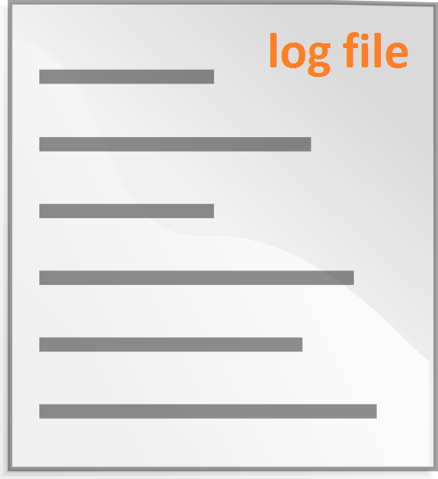

Database Checkpoints
  A checkpoint is a periodic operation that forces all committed changes recorded in the transaction log to be written to the data file(s).
checkpoint

Slide 23



Writes to the Database
Update to data
memory buffer
checkpoint

Slide 24
How DB Actually Works
  In the normal operation of your database, activities that you perform are “logged” to the transaction log first rather than written directly to the database.
  Data in your database is combination of data in physical database file(s) but also any transactions that have been committed to the log since the last checkpoint.
Checkpoint – periodic operation that forces all “dirty” pages for the database currently in use to be actually written to the database.
Dirty pages – data that has been modified, but the modifications have not been yet been written to disk (i.e. the data file).
All this happens automatically in background.

Slide 25
When Checkpoints Are Issued
Manual CHECKPOINT command
At normal shutdown of server
  Unless WITH NOWAIT option used
When you change any database option
When the Simple Recovery option is used and the log becomes 70% full
When amount of data in log since last checkpoint (active portion) exceeds size that server could recover in amount of time specified in recovery interval option

Slide 26
FAILURE and RECOVERY
Recovery happens every time SQL Server starts up.
  SQL server applies every committed transaction in log since last checkpoint to database file(s)
  Any changes to log that are not committed are rolled back-they are essentially forgotten

Slide 27
Locks and Concurrency
Concurrency – two or more users each trying to interact with the same object at the same time.
  Concurrency can be critical to the performance of your system
  The foundation of dealing with concurrency is the process of locking
Locks are a mechanism for preventing a process from performing an action on an object that conflicts with something already being done on that object.
  What you can and cannot do depend on what the other user is doing

Slide 28
Locks as a Concept
Think of your database as a crystal shop – lots of people can be looking at things, even the same thing, as long as they don’t move it, buy it, or otherwise change it. If more than one person does try to do one of these, the crystal will probably break.
The SQL Server lock manager is the “shopkeeper” that keeps a close eye on things.
  If you say “just looking”, the lock manager will let you in. But if you want to buy it (update or delete) something, then the lock manager will check to see if anyone’s already there. If so, you must wait. When you are let in to “buy”, no one else will be let in until you are done.

Slide 29
Locks
Can have many simultaneous reads on an object
  Everyone is just looking at the data – no conflict
Process can request “read only” access or “write” access
Typically only one write on an object is allowed at the same time

Slide 30
Lock Manager
If initial request for an object is read only, the object is locked for writing until read request is completed. Other read requests are allowed.
If write request is made, and no current read requests exist, then write access is granted, and everything locked out until write is completed.

Slide 31
Problems Prevented by Locks
Dirty reads
Non-repeatable reads
Phantoms
Lost updates
Need to correctly set “transaction isolation level” to prevent these problems

Slide 32
Transaction Isolation Level
Syntax
Example:
SET TRANSACTION ISOLATION LEVEL { READ UNCOMMITTED | READ COMMITTED | REPEATABLE READ | SNAPSHOT | SERIALIZABLE } [ ; ]
USE NorthWnd;
GO
SET TRANSACTION ISOLATION LEVEL REPEATABLE READ;
GO

Slide 33
Transaction Isolation Level
Only one of the isolation level options can be set at a time, and it remains set for that connection until it is explicitly changed.
Default Isolation Level is READ COMMITTED

Slide 34
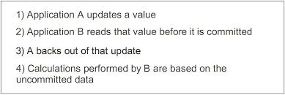
Dirty Reads
Consider when a transaction reads a record that is part of another transaction that isn’t completed yet.
  What happens if transaction rolls back?
This situation cannot happen if you are using SQL Server default for transaction isolation level (called READ COMMITED)

Slide 35
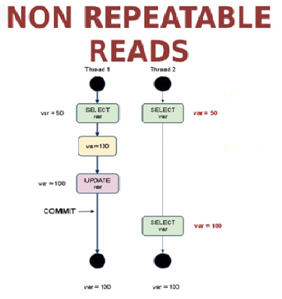
Non-Repeatable Reads
A non-repeatable read occurs when you read the same record twice in a transaction, and a separate transaction alters that data in the interim.
  Easy to confuse with dirty read
Can prevent in two ways
  Check constraint, and to monitor for 547 error
    Reactive approach – check if problem has happened
  Set our isolation level to be REPEATABLE READ or SERIALIZABLE
    Can cause as many problems
    as it fixes – but an option

Slide 36
Phantoms
Records that appear “mysteriously”, as if unaffected by an update or delete statement that you have already issued
Example – Let’s say you have an employees table and you want to update all your employee records to have an hourly rate of 7.25 to reflect the new minimum wage requirements.
  update to new minimum wage:
  update employees
  set hourlyRate = 7.25 where hourlyRate <7.25
  alter table employees
  add ckWage Check (HourlyRate >=7.25)
  If someone ran an insert while your update was running (very rare), then your ckWage contraint could error. You would go check your data and find that there is still a row where the hourlyRate < 7.25
  Cure by setting transaction isolation level to SERIALIZABLE

Slide 37
Lost Updates
Lost Updates is when an update is successfully written to database but then is overwritten by another transaction.
  Two transactions read a record
  First makes change
  Second make change, losing first update
Example: You are a credit analyst and trying to extent a customer’s credit limit from 5000 to 7500. While you are looking at her data, another analyst pull up the record for the customer intending to do a change of address. You submit your change, thus updating the database. However, the other analyst is using the same edit screen that contains all fields for the customer (including credit limit). That analyst’s screen still has the value of 5000, so when they try to submit the page, all of those values are stored in the database and the increase in credit limit was overridden.

Slide 38
Lockable Resources
Database – entire database can be locked. This happens usually during database schema changes.
Table – entire table can be locked, including ALL data-related objects including ALL data rows, and ALL keys in ALL indexes
Extent – entire extent (data or index) is locked (8 64K pages of data)
Page – all data or index keys on that page are locked
Key – lock on particular or series of keys
Row – technically row identifier (RID – internal SQL server construct)

Slide 39
Lock Escalation – Technique used by the lock manager to avoid performance issues when locking. When the number of locked objects being maintained reaches a threshold, the lock is escalated to the next higher level.
  Number of locks is critical, not number of users
  Keep queries as targeted as possible

Slide 40
Lock Modes
As important as what-is-being-locked is the LOCK MODE
Shared locks
  Most basic lock
  Used for read-only access – allows others to read but not update
  Is compatible with other locks
  Prevents dirty reads
Exclusive Locks
  No one else can read or write or lock
  Not compatible with other locks
  Prevents two people from updating, deleting, etc. at the same time.
Update lock
  Hybrid between shared and exclusive
  Indicate that you have a shared lock that is going to become an exclusive lock after you’ve scanned and found your data. (Recall it is probably using a WHERE clause)
  Avoids deadlocks
  Compatible with shared locks and intent shared locks

Slide 41
Isolation Level
We’ve spent time talking about locks…but what do they have to do with transactions?
Transactions and locks are inextricably linked.
By default, any lock that modifies data will, once created, be held for the duration of the transaction.
  This means that by default long transactions will lock out other processes
There exists FOUR different isolation levels you can set:
  READ COMMITTED (default)
  READ UNCOMMITTED
  REPEATABLE READ
  SERIALIZABLE

Slide 42
Isolation Level Syntax
The syntax for switching between isolation levels is as follows:
  SET TRANSACTION ISOLATION LEVEL
  <READ COMMITTED |
  READ UNCOMMITTED |
  REPEATABLE READ |
  SERIALIZABLE >
Changes in isolation level will only affect the current connection – so you don’t need to worry about adversely affecting other users (or them affecting you).

Slide 43
READ COMMITTED (Default)
Any shared locks you create will be automatically released as soon as the statement that created them is complete.
  Example: If you start a transaction, run several statements, run a SELECT statement, and then run several more statements, the locks associated with the SELECT are freed as soon as the SELECT is complete - SQL Server does not wait until the end of the transaction.
Actions (update, delete, insert) - the lock will be held for the duration of the transaction, in case you need to rollback.
Outcome? Dirty reads are prevented, but non-repeatable reads and phantoms can still occur.

Slide 44
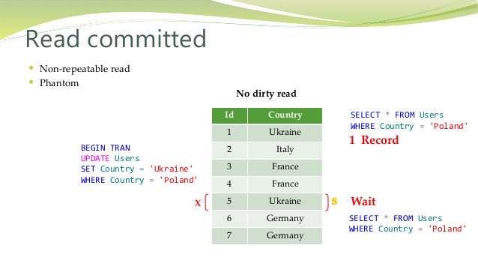
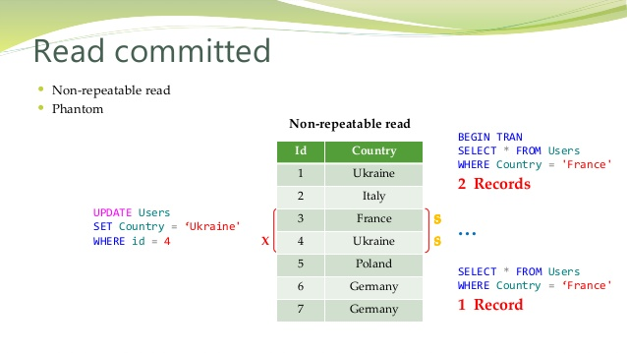

Slide 45
READ UNCOMMITTED
Most dangerous of all isolation levels, but has highest performance in terms of speed.
Tells SQL server not to set locks and not to honor and locks.
With this isolation level, it is possible to experience any of the various concurrency issues we discussed.
Why use this? It is often used for reporting.
  Run reports with read uncommitted since ballpark numbers are all that is required.
Get same results by using NOLOCK optimizer hint with your query
  NOLOCK applies to only the query instead of the entire connection, so you have to use it on every query if you want the same effect as READ UNCOMMITTED.
  With READ UNCOMMITTED you have to remember to set the isolation level back to the default.

Slide 46
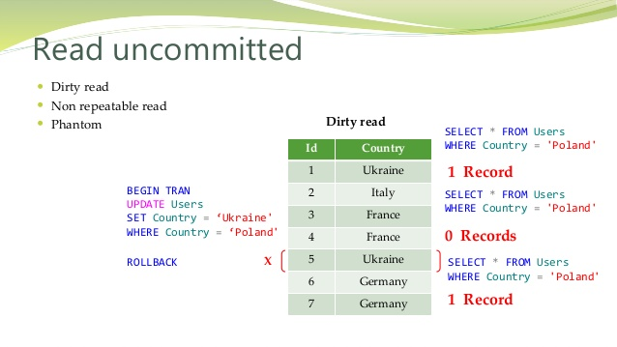

Slide 47
REPEATABLE READ
Shared locks are placed on all data read by each statement in the transaction and are held until the transaction completes. This prevents other transactions from modifying any rows that have been read by the current transaction.
Extra level of concurrency protection by preventing both dirty reads and non-repeatable reads
Equivalent optimizer hint is REPEATABLEREAD.
Holding shared locks until end of transaction can hurt productivity.
  The author recommends using the default of READ COMMITTED in most cases instead of REPEATABLE READ.

Slide 48
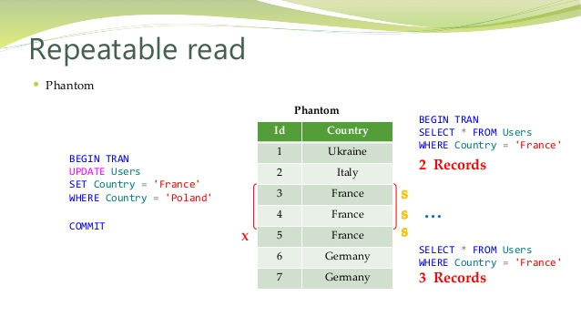

Slide 49
SERIALIZABLE
Any UPDATE, DELETE, or INSERT to the tables used by your transaction must not meet the WHERE clause of any statement in your transaction.
  If the user was going to do something that your transaction would be interested in, then it must wait until your transaction has completed.
Prevents all forms of concurrency issues except for a lost update.
  But concurrency and consistency are opposites – this can REALLY SLOW THINGS DOWN
SERIALIZABLE or HOLDLOCK are equivalent optimizer hints for the SERIALIZABLE isolation level.
Most conservative.
Stick to default unless really important reasons for doing otherwise.

Slide 50
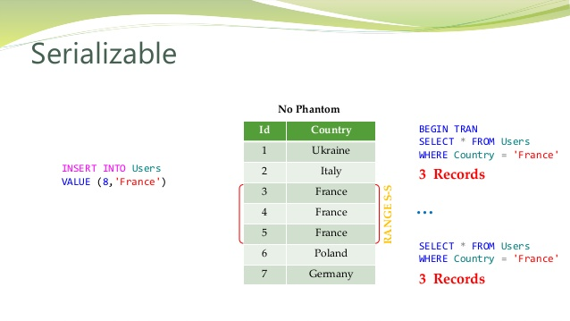

Slide 51
Optimizer Hints
Locks are generally handled automatically and should be kept that way – however …
  Optimizer hints are ways of explicitly telling SQL Server to escalate a lock to a specific level: Optimizing Locking
  ADVANCED TOPIC
  Often abused by “experienced” SQL Server developers

Slide 52
Determining Locks using Management Studio
Management Studio has a way to take a look at your locks – by process ID, or by object, by utilizing the Activity Monitor.
Navigate to Management->Activity Monitor
Right click ‘Process’ gives you options to:
  View Details - This includes the last query run
  Kill the process - You may need to do this if you ever get into a deadlock situation.

Slide 53
Deadlock
Suppose two update queries running in shared mode.
  Query A completes query and is ready for physical update – wants to exclusive to exclusive lock, but can’t as query B still has shared lock.
  Query B finishes query and now needs to do physical update, but can’t as query A still has shared lock.
    IMPASSE!!
An Update lock solves this, as it prevents other update locks from being established.

Slide 54
Deadlocks (“A 1205”)
Error number 1205
One lock cannot do what it needs in order to clear because a second lock is holding that resource and vice versa (could be more than two, or twenty…)
SQL server chooses a “deadlock victim” – that transaction is rollback and is notified of what happened with a 1205.

Slide 55
Detecting a Deadlock
Every 5 seconds SQL Server checks all current transactions for what locks they are waiting on but haven’t yet been granted.
If it rechecks after another 5 seconds and finds a previous lock request still pending, it recursively checks all open transactions for a circular chain of lock requests.
If circular chain found, then deadlock victim chosen.
  A deadlock victim is chosen based on the “cost” of the transactions involved. The transaction that costs the least to rollback will be chosen (i.e. SQL Server will have to do the least number of things to rollback).

Slide 56
Avoiding Deadlocks
Rules of thumb to reduce/eliminate deadlocks:
  Use objects in the same order
  Keep transactions as short as possible
  Use lowest transaction isolation level possible
  Do not create open-ended transactions

Slide 57
Same Objects, Same Order
This rule easy to implement with little cost and generates good results.
  Every query, procedure, trigger
  Example: If you access Orders and then Order Details in a procedure, try to do the same in all procedures that you create.

Slide 58
Short Transactions
The longer a transaction is open, the more it touches, and the higher the probability of locking something else out.

Slide 59
No Open-Ended Transactions
Don’t hold locks while waiting for user Input!
Someone in service department wants to use an update screen to view data
  Then goes on to view a work order
  Then forgets and goes to lunch
Not just user input, but any process that may have an open-ended wait

Slide 60
